Slide 1
Introduction to Computational Neuroscience
NEPR208
Theory
Biological Function
Computation
Mechanism
Stephen Baccus
John Huguenard
Surya Ganguli
Niru Maheswaranathan
Spring 2017

Slide 2
Why Model?
Joshua Epstein
Sixteen Reasons Other Than Prediction to Build Models
Explain (very distinct from predict)
Illuminate core dynamics
Suggest dynamical analogies
Discover new questions
Bound (bracket) outcomes to plausible ranges
Illuminate core uncertainties
Demonstrate tradeoffs / suggest efficiencies
Challenge the robustness of prevailing theory through perturbations
Expose prevailing wisdom as incompatible with available data
Reveal the apparently simple (complex) to be complex (simple)
http://jasss.soc.surrey.ac.uk/11/4/12.html

Slide 3
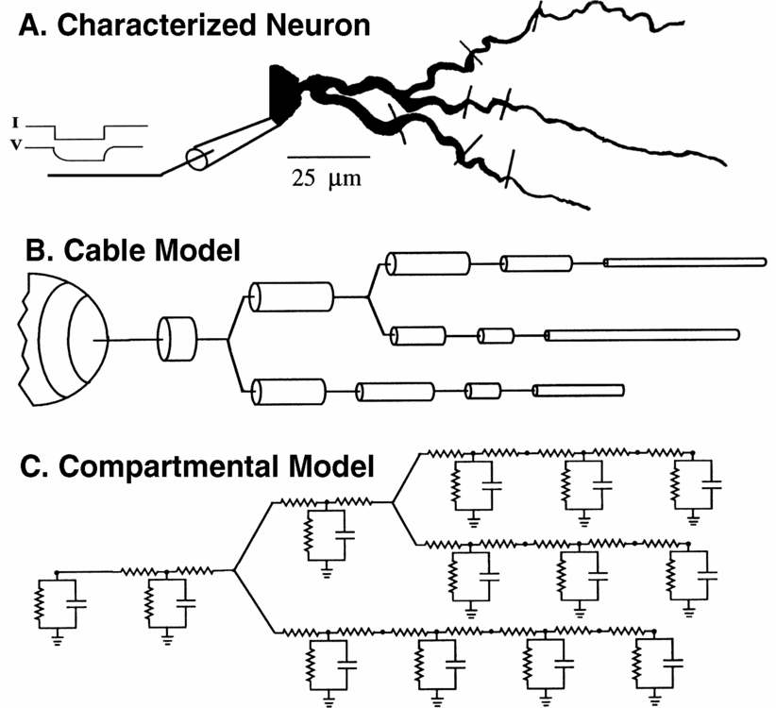
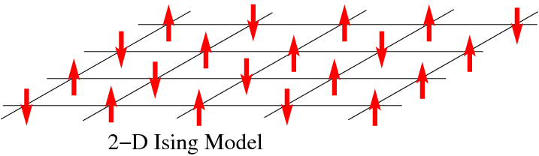
Many types of models for different purposes
Abstract
Biophysical
Statistical

Slide 4
How can a neuron change its gain?
How can a neuron maintain a stable firing pattern?

Slide 5
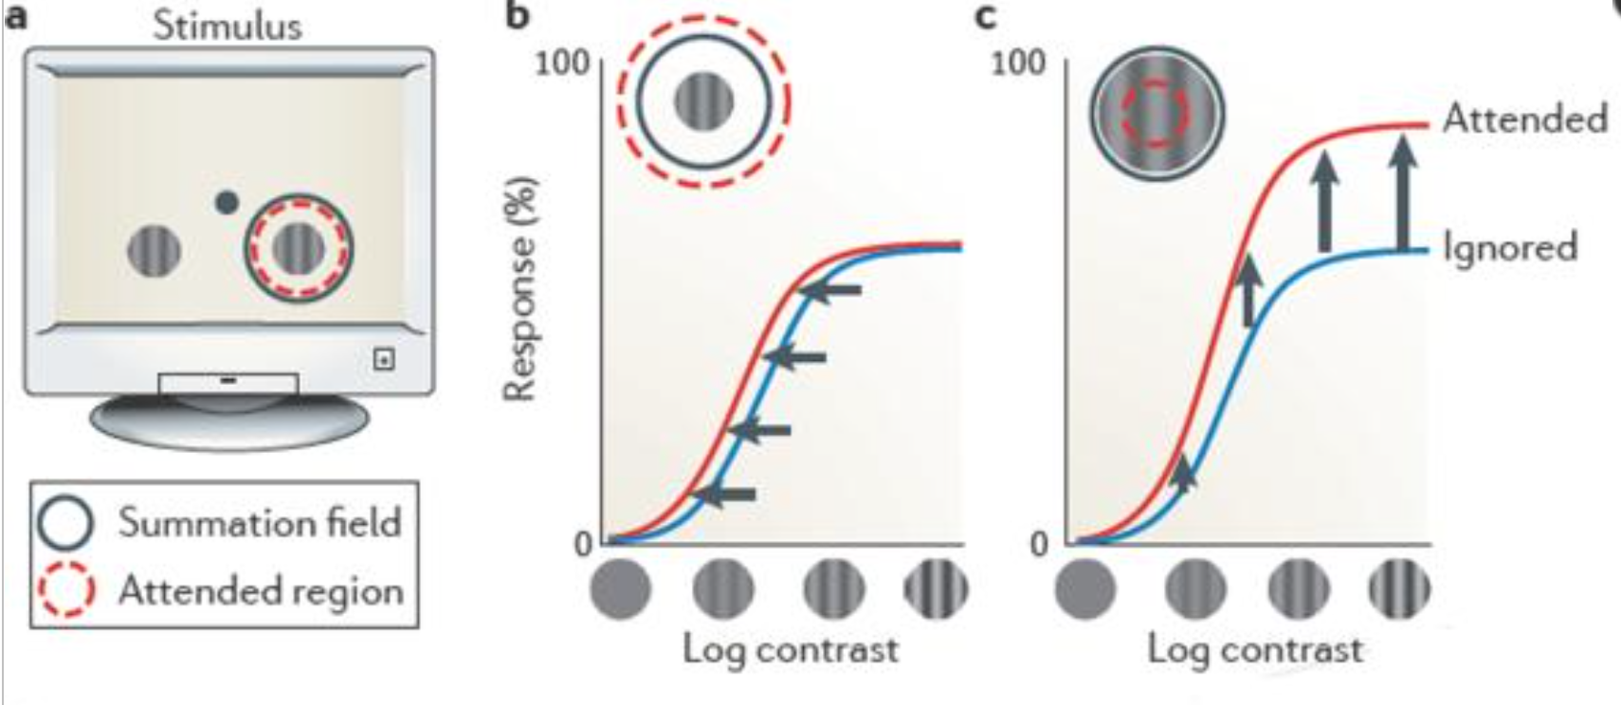
Changing gain in the nervous system
Reynolds & Heeger, 2009

Slide 6
How can a neuron control its gain?

Slide 7
Integrate and fire neuron
Sum of currents
Tau
Conductance models

Slide 8
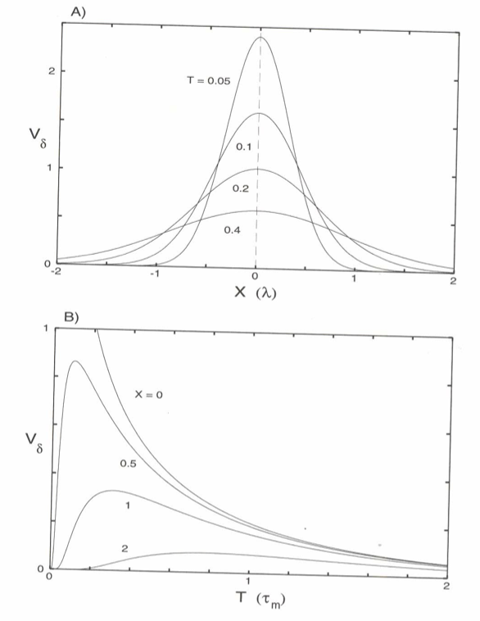
Due to filtering along a cable, distant locations
have a delayed peak
From Koch, Biophysics of Computation, Oxford Press, 1999
Notes:
Top, Plot of voltage vs. space at different times. The four lines show the voltage profile at four different points in time after a brief pulse of current injected at spatial location X = 0. X is shown in units of the space constant lambda. At T=0, the there is a narrow peak of voltage. At later times, the peak spreads. The consequence of this is that at more distant spatial locations, the peak occurs with a delay.
Bottom. Plot of voltage vs. time at different spatial locations. The four lines show the voltage profile at four different spatial locations. At X=0. the peak occurs right away. At more distant locations, the voltage is attenuated and the peak occurs later in time. This is a consequence of the filtering through the cable.

Slide 9
Idea of Driving Force linear (ohmic) input output relationship for individual channel type
I
V
Notes:
For a membrane with only potassium channels in it, and a negative E(K),
the arrows indicate the direction that current would tend to make voltage change. When the membrane potential is more positive than E(K), the current drives the voltage more negative. When the membrane potential is more negative than E(K), the current drives the voltage more positive. Thus, E(K) is the equilibrium where the voltage doesn’t change.

Slide 10
Rate constants
Closed
Open
State
Occupancies
(sum to 1)
R
A
Change in
activity = Inflow – Outflow
Kinetic model

Slide 11
Input and output in a kinetic model
Closed
Open
R
A
Active
Resting
[L]k_{on}
k_{off}

Slide 12
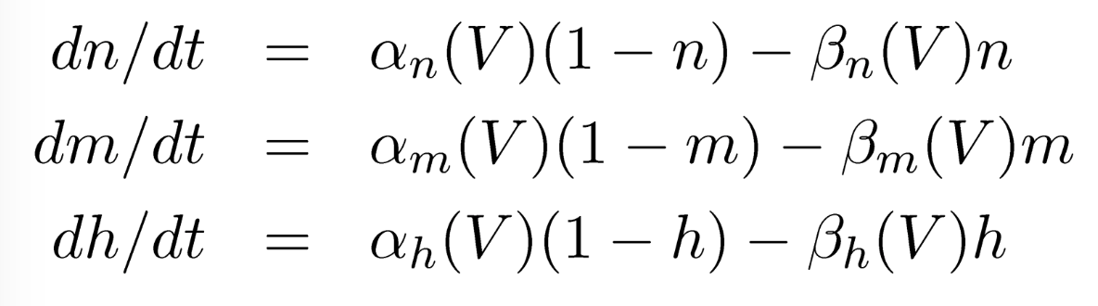
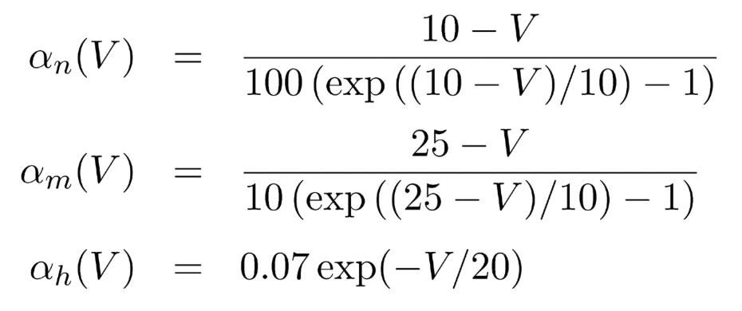
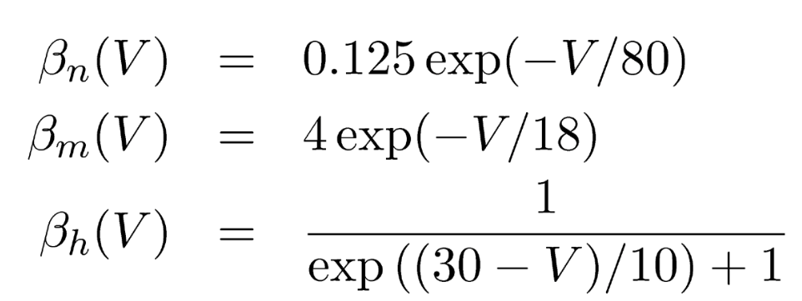
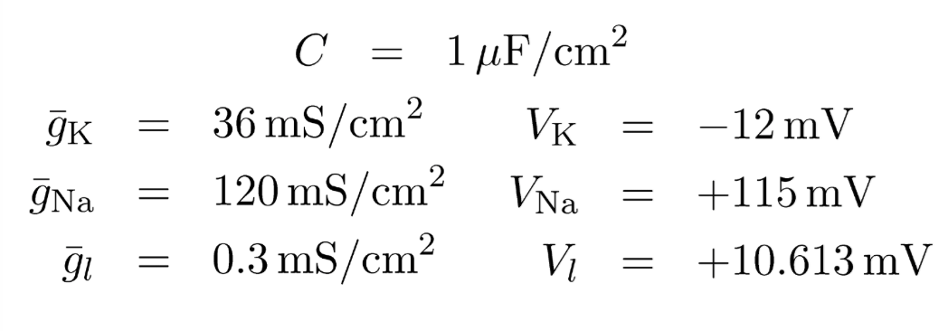
Hodgkin Huxley Model
Voltage state variable (membrane equation):
Conductance state variables:
Rate “constants”:
Constants:
Note: these are given in
the original form,
relative to V_{rest} =~ -66 mV

Slide 13
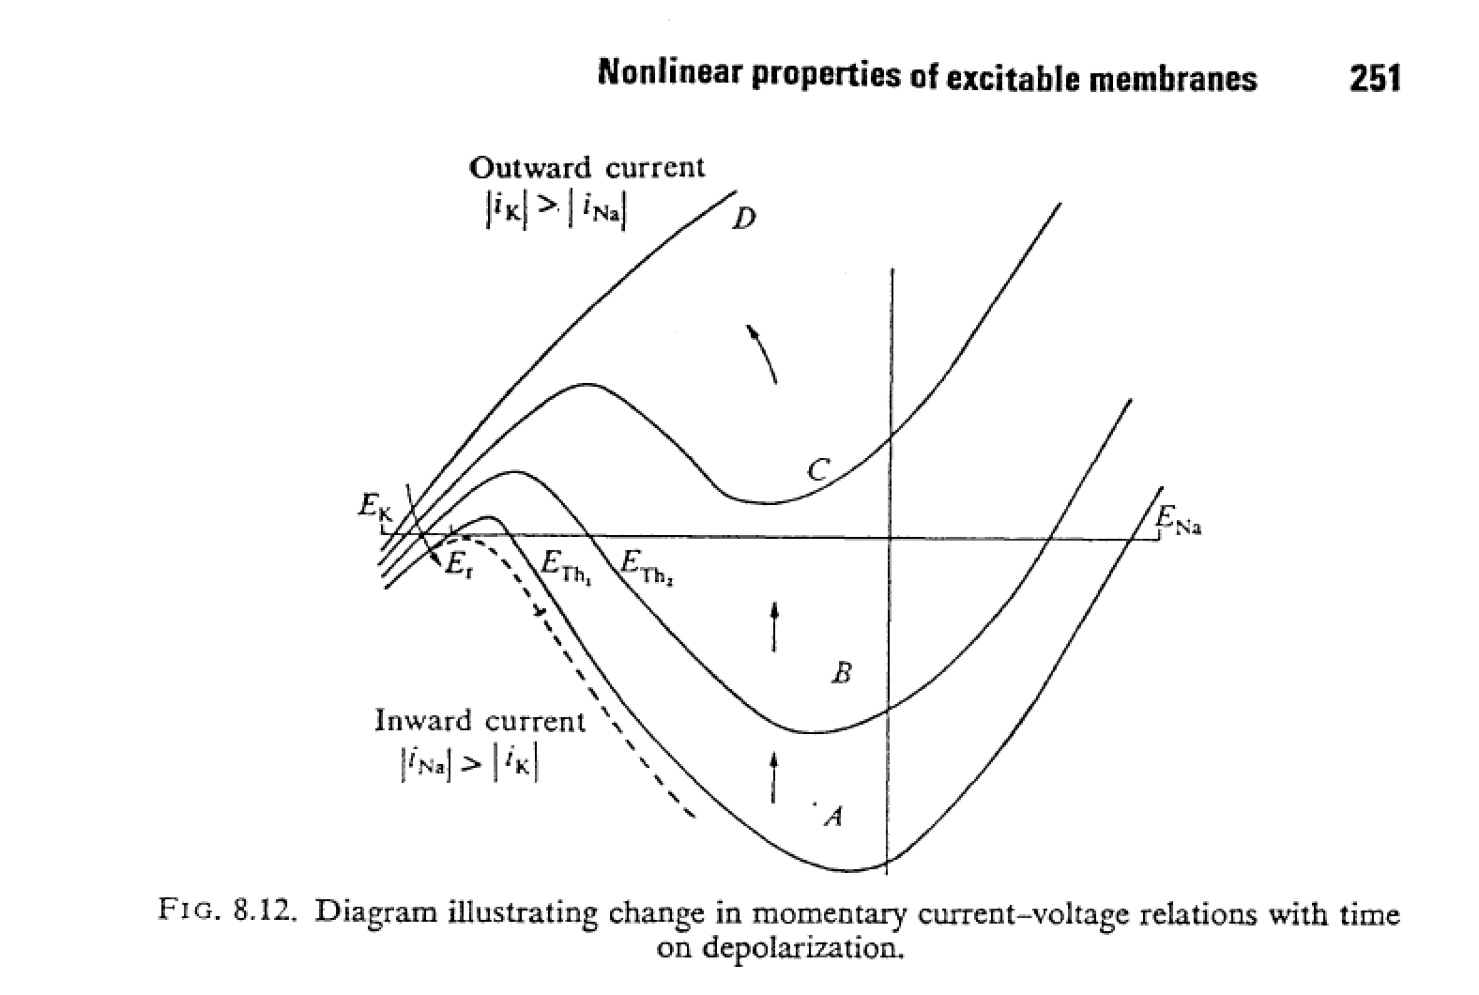
Notes:
This figure is from Jack Noble and Tsien, 1975 p. 251. N-shaped current voltage (I-V) curves are typical of excitable cells and systems. An electronic component with this property is called a tunnel diode. This shows how the I-V curve of an excitable cell changes over time as sodium channels close. The key thing here is the three points where the curve intersects the x-axis. Resting potential, threshold and the peak of the action potential. Also note that when enough inactivation occurs, threshold disappears, and the cell is no longer excitable.

Slide 14
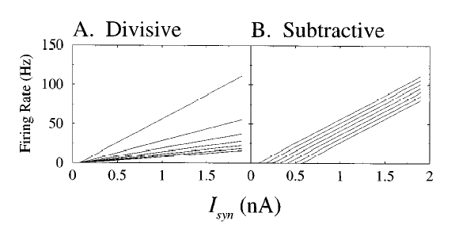
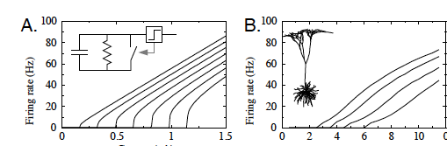
Current (nA) Excitatory synaptic input rate (Hz)
Holt & Koch, 1997. Shunting inhibition does not have a divisive effect on firing rates

Slide 15
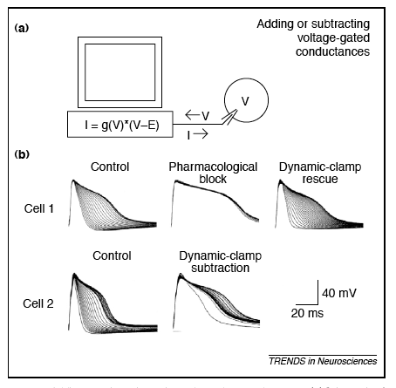
The dynamic clamp
Artificially adding or subtracting membrane mechanisms

Slide 16
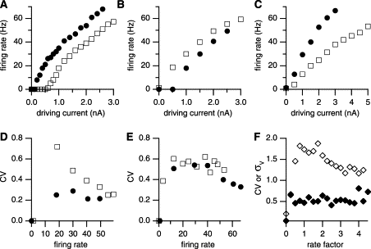
Balanced excitation and inhibition can change gain
Rat somatosensory cortex slice
Shunting inhibition alone
Balanced excitation and inhibition
Chance, Abbott & Reyes. (2002) Gain modulation from background synaptic input.

Slide 17
How can a neuron maintain a stable firing pattern?

Slide 18
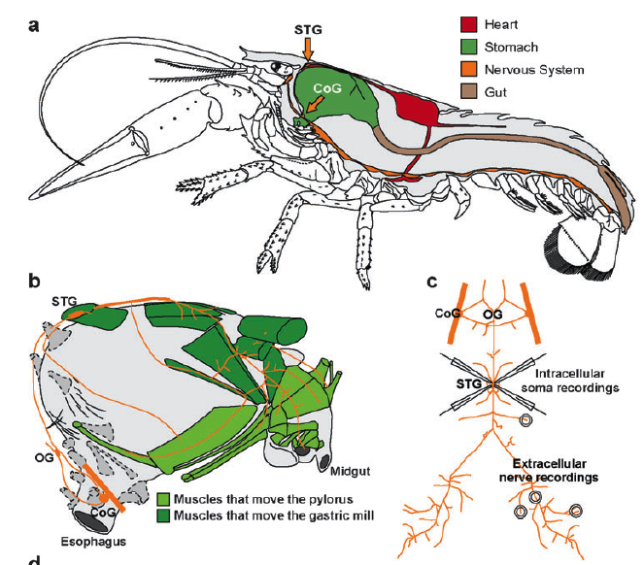
Crustacean stomatogastric ganglion
Marder, E. & Bucher, D., 2006

Slide 19
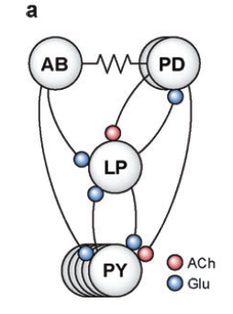
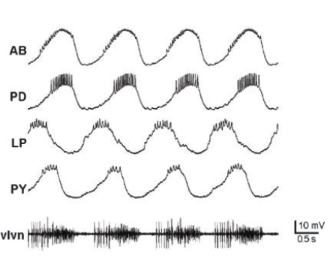
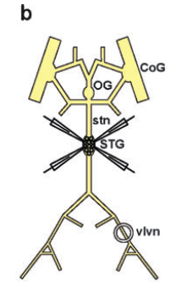
Pyloric oscillator of the stomatogastric ganglion
AB: Anterior burster
PD: Pyloric dilator
LP: Lateral Pyloric
PY: Pyloric
Note: these are inhibitory

Slide 20
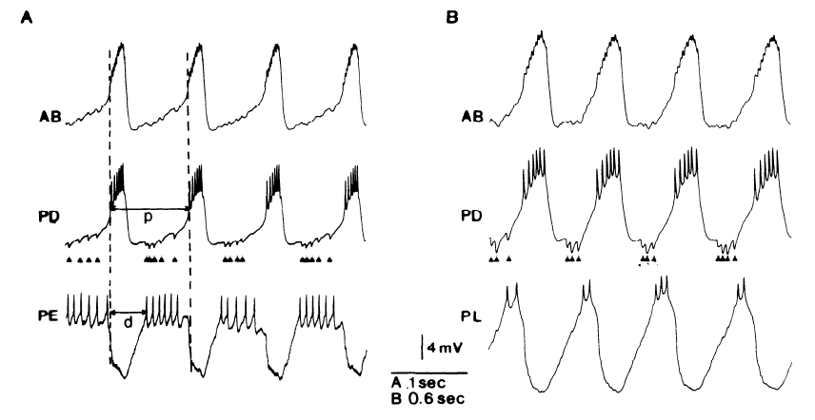
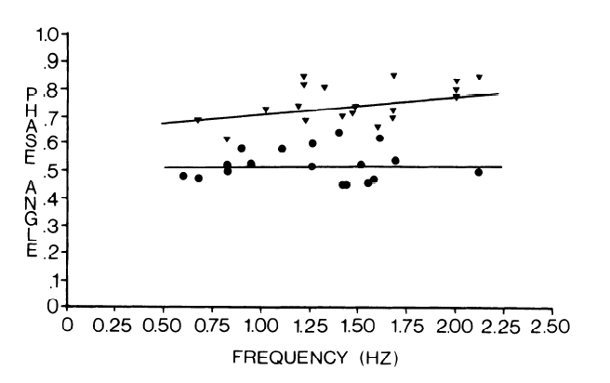
Phase constancy across oscillation frequency

Slide 21
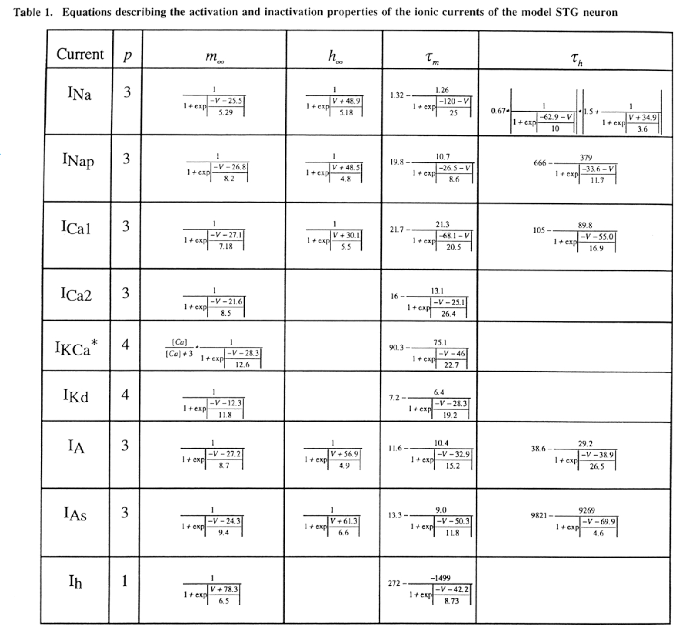
Many conductances, how are they regulated?

Slide 22
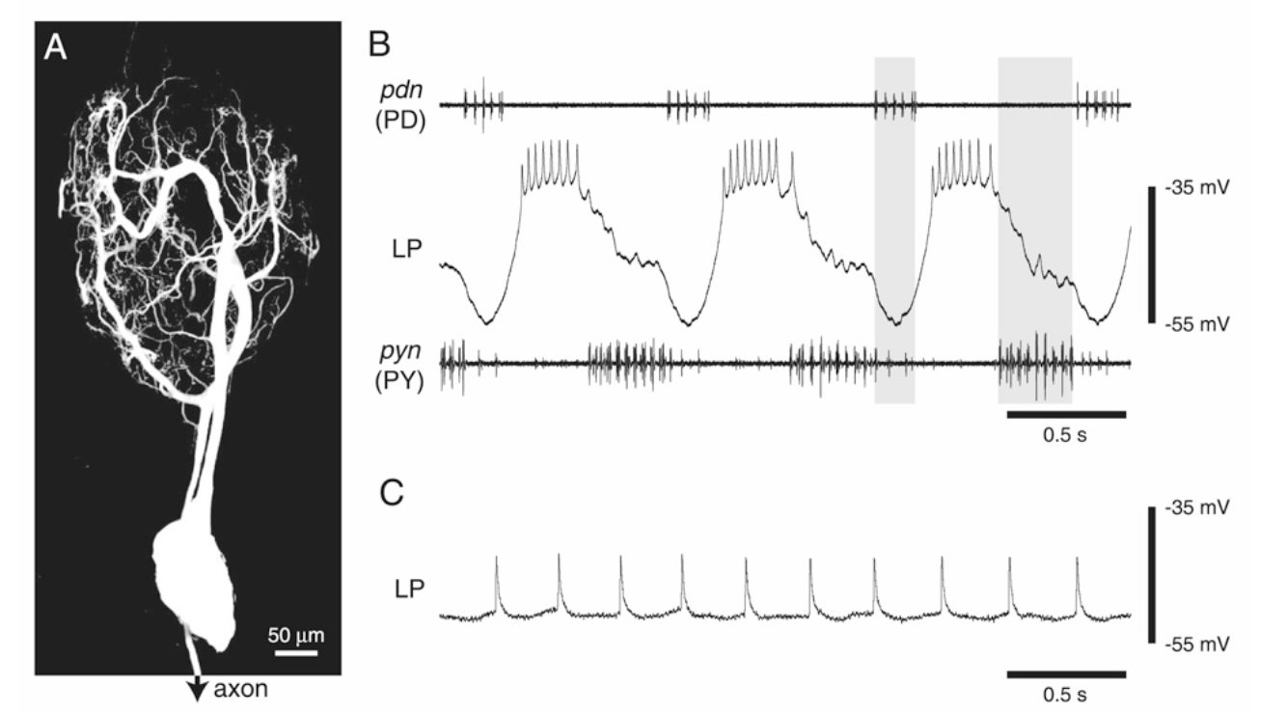

Slide 23
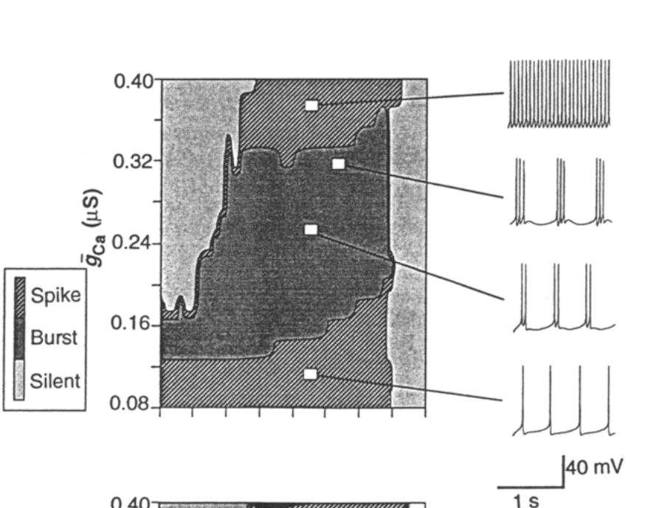
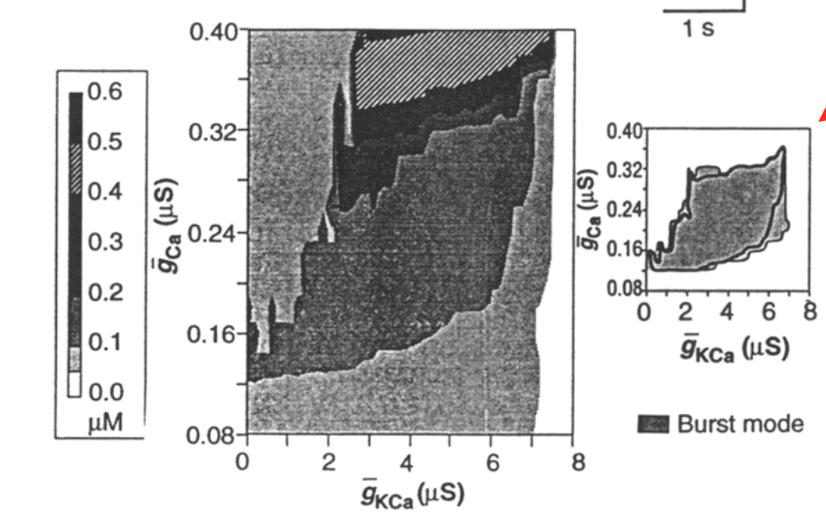
Different dynamic behavior in different regions of parameter space
LeMasson, Abbott and Marder, 1993

Slide 24
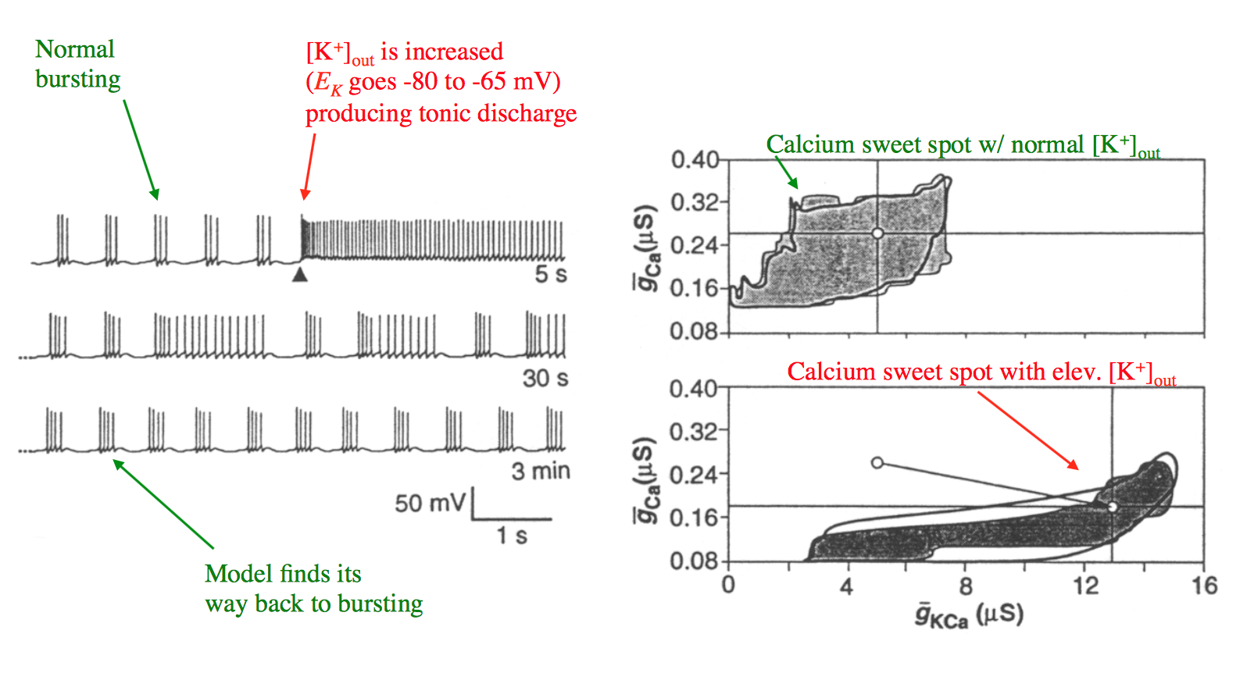
Ca
K+ is increased here, E_{K} changed from – 80 to -60 mV
Normal K+
Bursting
[Ca] 0.1 – 0.3 mM
Elevated K+
Change in model behavior
Returns to bursting

Slide 25
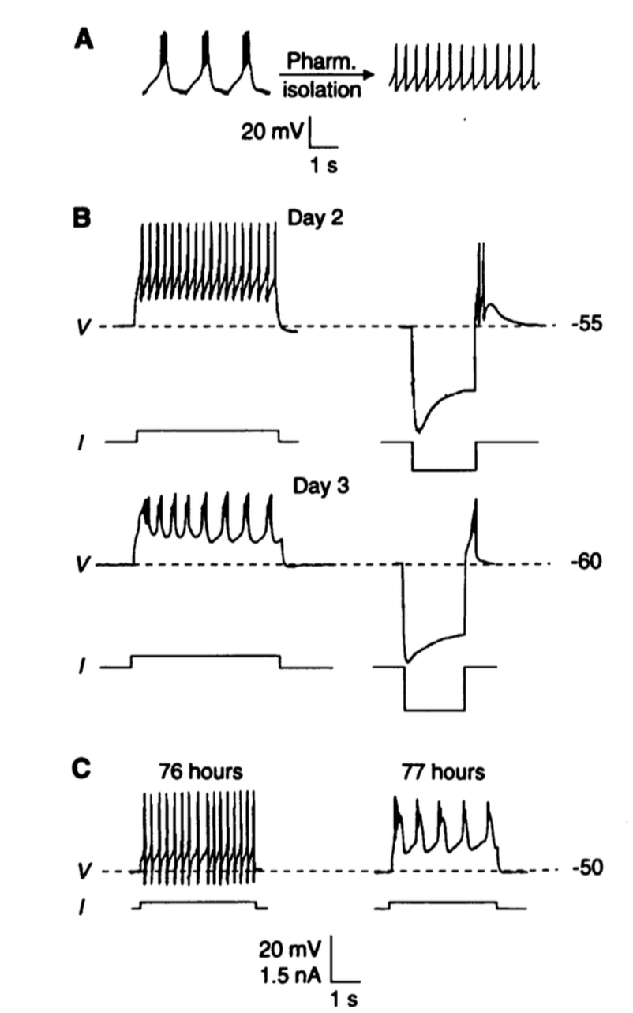
Cells change their physiological properties to burst
Turrigiano et al., 1994

Slide 26
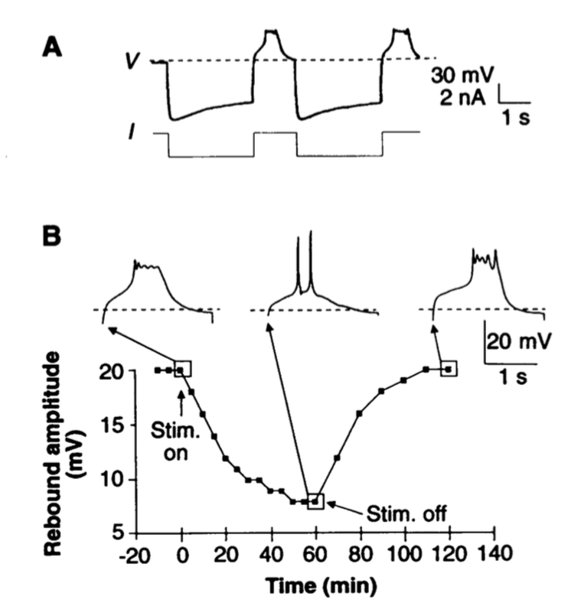

Slide 28
What influence do dendrites have on computation?

Slide 29
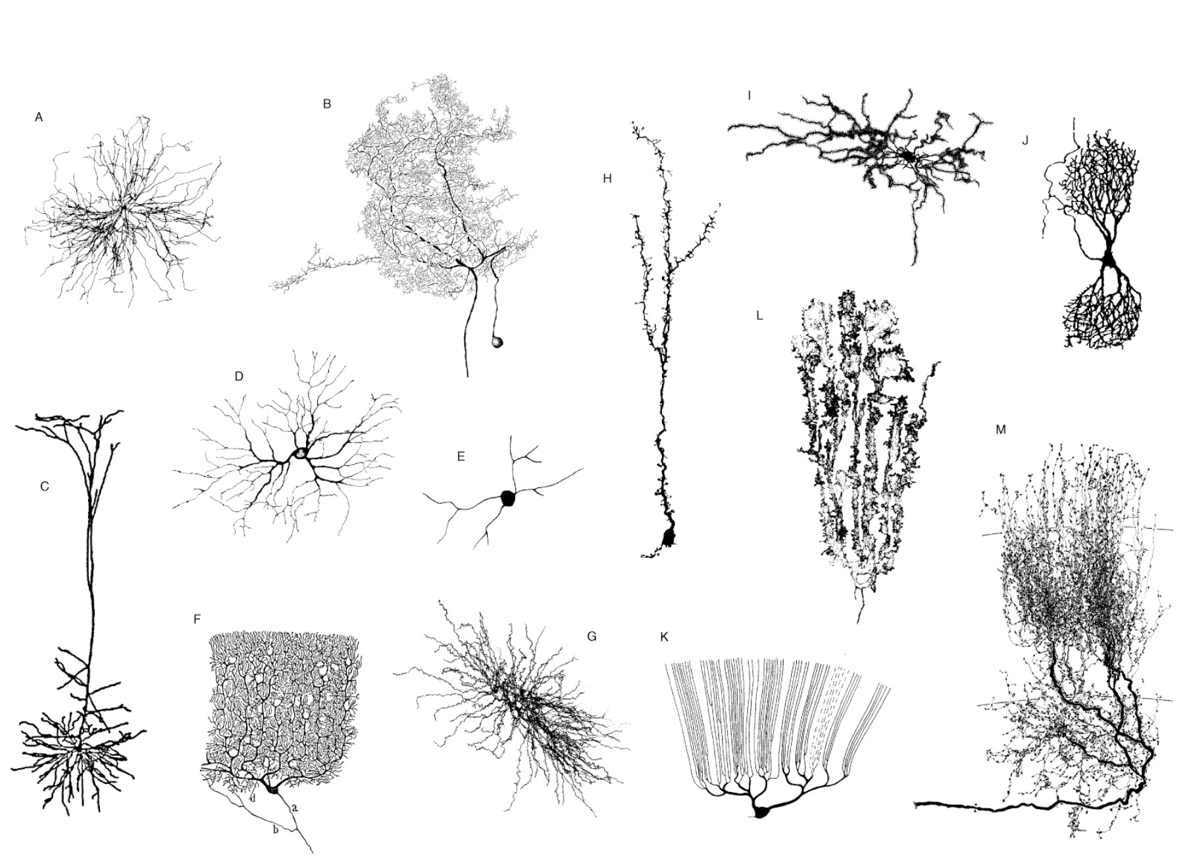

Slide 30
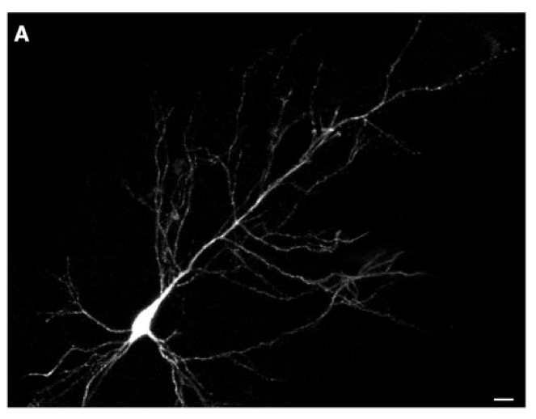
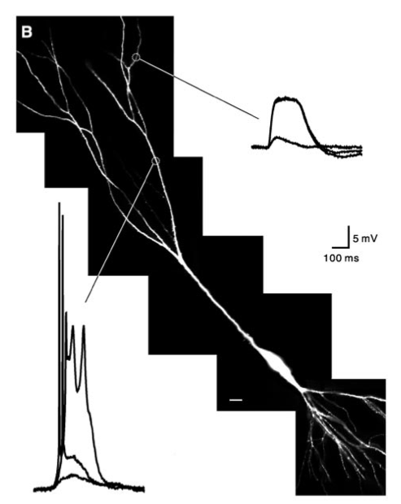
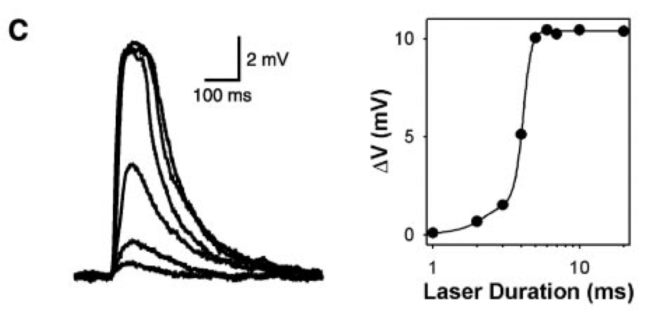
All or none calcium action potentials in pyramidal cell dendrites
Wei et al., 2001. Compartmentalized and Binary Behavior of Terminal Dendrites in Hippocampal Pyramidal Neurons
Notes:
Calcium action potentials can be measured in some dendrites. Here, caged glutamate is being released onto a cell. This is a synthetic glutamate analog that is inactive, because there is an additional molecule attached to the glutamate. When light is absorbed by the molecule, it cleaves, releasing glutamate that then can bind to glutamate receptors.
Calcium action potentials occur when the cell depolarizes sufficiently to open a large calcium current, which then further depolarizes the cell producing positive feedback. Eventually (~50 – 100 ms) calcium channels inactivate (close), even though the cell is still depolarized, thereby ending the action potential.

Slide 31
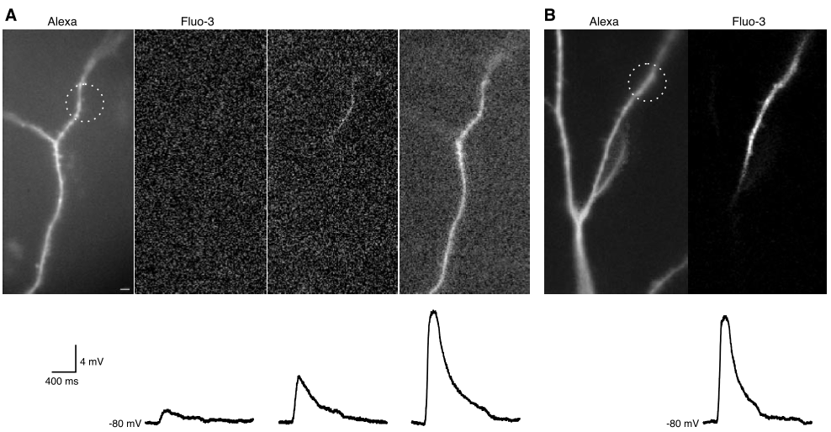
Action potential failure at a dendritic branch point
Wei et al., 2001. Compartmentalized and Binary Behavior of Terminal Dendrites in Hippocampal Pyramidal Neurons
Notes:
A. Left, a fluorescent dye fills the cell, showing its dendrites. Next three panels: Three different levels of caged glutamate are released onto the cell, eventually producing a calcium action potential. The dye Fluo-3 is a calcium senstiive dye that fluoresces when it binds calcium. Thus the calcium influx from the action potential can be directly imaged. B. The calcium action potential fails to invade the entire cell and fails at a branch point, because the greater capacitance of membrane near the branch point can’t be depolarized by the currents in the smaller branch where the action potential originated.

Slide 32
Properties of feature detection
Selectivity
Invariance

Slide 33
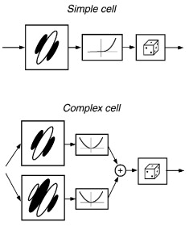
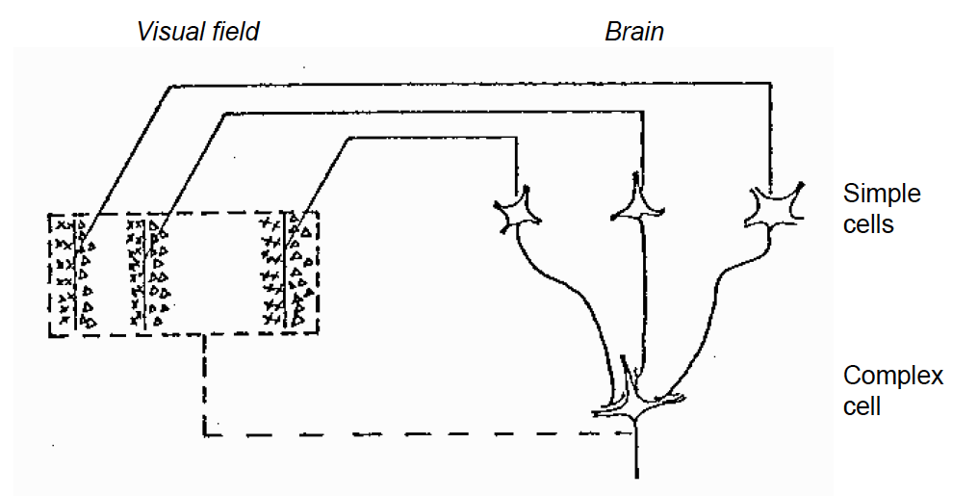
Models of selectivity and invariance in primary visual cortex
Hubel & Wiesel, 1963
Rust et al., 2005

Slide 34
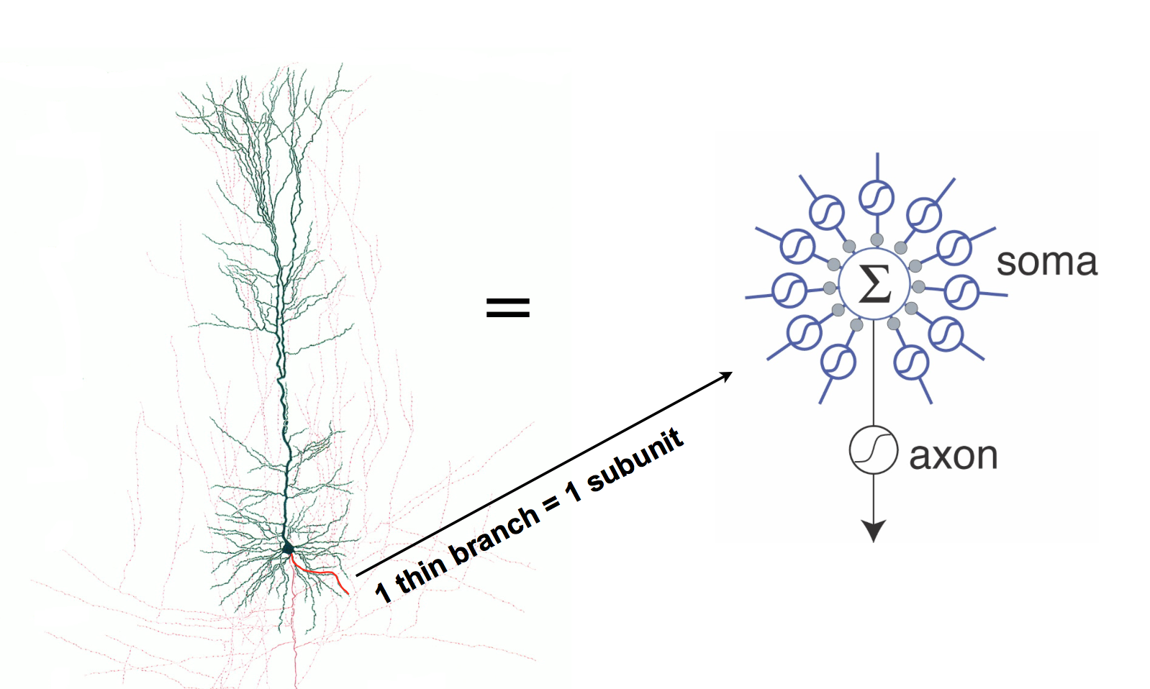
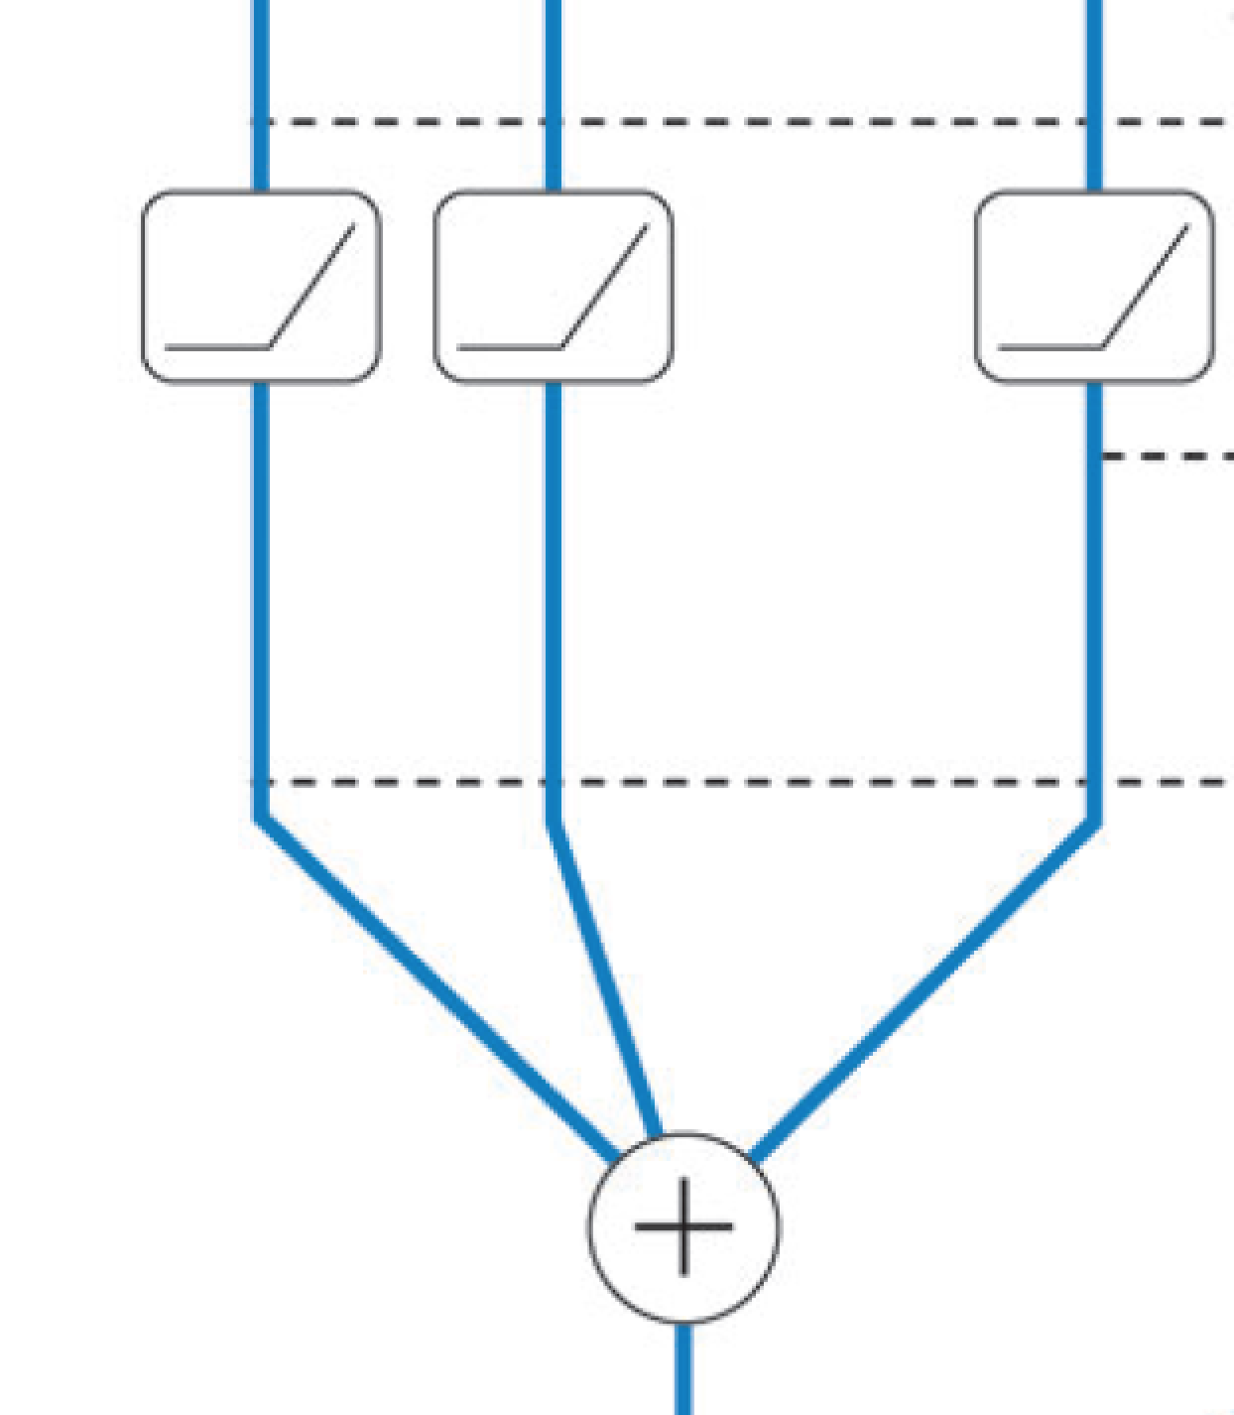

dendrites
soma
axon

Slide 35
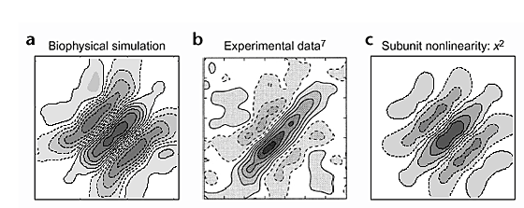
Model of Binocular Disparity Representation
Bar presented to left & right eyes
Right eye pos. (deg)
Left eye pos. (deg)
Archie & Mel (2000)

